Slide 1
Unit 6

Slide 2


Slide 3
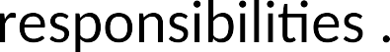




Slide 4
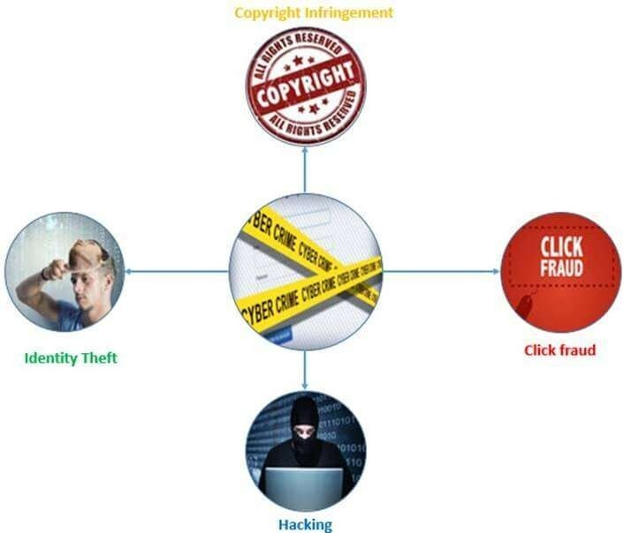

Slide 5
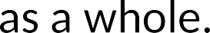



Slide 6
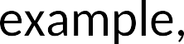
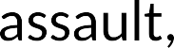

Malicious burning to destroy property

Slide 8
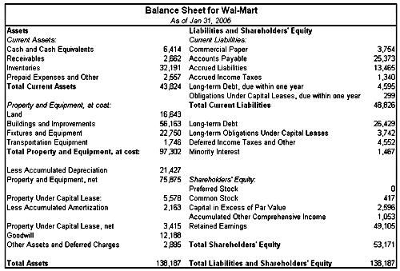

Slide 9



Slide 10

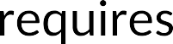


Slide 11

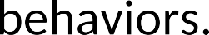

Slide 12
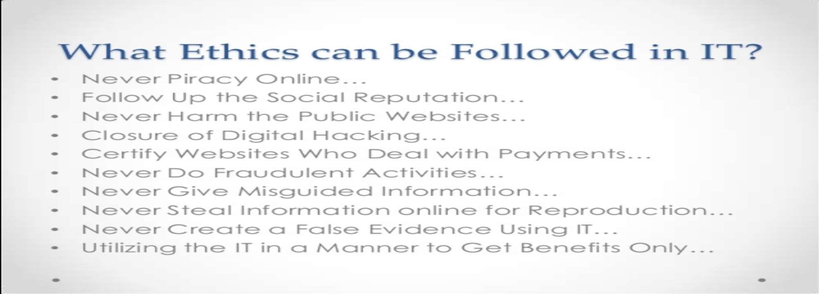

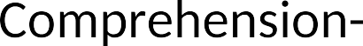
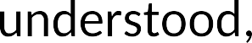
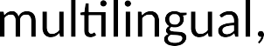
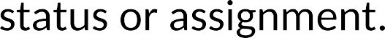

Slide 13
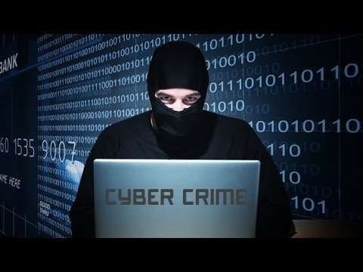

Slide 14









Slide 15







The Organisation for Economic Co-operation and Development (OECD) is an international organisation of those developed countries that accept the principles of representative democracy and a free market economy.
https://www.oecd.org/env/tools-evaluation/oecdcouncilrecommendations.htm

Slide 16
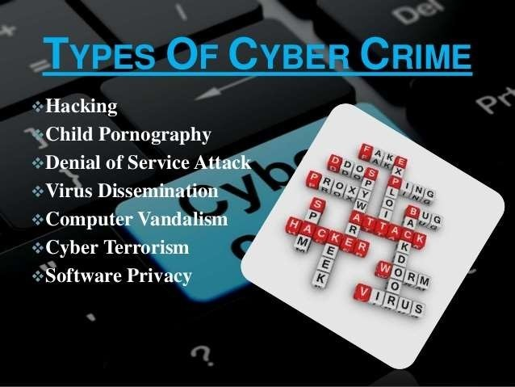

Slide 17
Types of software attacks
Malware is a combination of 2 terms- Malicious and Software. Malware can be divided in 2 categories:
Infection Methods
Malware Actions

Slide 18
Types of software attacks
Malware on the basis of Infection Method are following:
Virus – They have the ability to replicate themselves by hooking them to the program on the host computer like songs, videos etc and then they travel all over the Internet. The Creeper Virus was first detected on ARPANET. Examples include File Virus, Macro Virus, Boot Sector Virus, Stealth Virus etc.
Worms – Worms are also self-replicating in nature but they don’t hook themselves to the program on host computer. Biggest difference between virus and worms is that worms are network-aware. They can easily travel from one computer to another if network is available and on the target machine they will not do much harm, they will, for example, consume hard disk space thus slowing down the computer.

Slide 19
Types of software attacks
Malware on the basis of Infection Method are following:
Trojan – The Concept of Trojan is completely different from the viruses and worms. The name Trojan is derived from the ‘Trojan Horse’ tale in Greek mythology, which explains how the Greeks were able to enter the fortified city of Troy by hiding their soldiers in a big wooden horse given to the Trojans as a gift. The Trojans were very fond of horses and trusted the gift blindly. In the night, the soldiers emerged and attacked the city from the inside. Their purpose is to conceal themselves inside the software that seem legitimate and when that software is executed they will do their task of either stealing information or any other purpose for which they are designed.
They often provide backdoor gateway for malicious programs or malevolent users to enter your system and steal your valuable data without your knowledge and permission. Examples include FTP Trojans, Proxy Trojans, Remote Access Trojans etc.

Slide 20
Types of software attacks
Malware on the basis of Infection Method are following:
Bots –: can be seen as advanced form of worms. They are automated processes that are designed to interact over the internet without the need for human interaction. They can be good or bad. Malicious bot can infect one host and after infecting will create connection to the central server which will provide commands to all infected hosts attached to that network called Botnet.

Slide 21
Types of software attacks
Malware on the basis of Actions:
Adware – Adware is not exactly malicious but they do breach privacy of the users. They display ads on a computer’s desktop or inside individual programs. They come attached with free-to-use software, thus main source of revenue for such developers. They monitor your interests and display relevant ads. An attacker can embed malicious code inside the software and adware can monitor your system activities and can even compromise your machine.

Slide 22
Types of software attacks
Malware on the basis of Actions:
Spyware – It is a program or we can say software that monitors your activities on computer and reveal collected information to an interested party. Spyware are generally dropped by Trojans, viruses or worms. Once dropped they install themselves and sits silently to avoid detection. One of the most common example of spyware is KEYLOGGER. The basic job of keylogger is to record user keystrokes with timestamp. Thus capturing interesting information like username, passwords, credit card details etc.
Ransomware – It is type of malware that will either encrypt your files or will lock your computer making it inaccessible either partially or wholly. Then a screen will be displayed asking for money i.e. ransom in exchange

Slide 23
Types of software attacks
Malware on the basis of Actions:
Scareware – It masquerades as a tool to help fix your system but when the software is executed it will infect your system or completely destroy it. The software will display a message to frighten you and force to take some action like pay them to fix your system.
Rootkits – are designed to gain root access or we can say administrative privileges in the user system. Once gained the root access, the exploiter can do anything from stealing private files to private data.
Zombies – They work similar to Spyware. Infection mechanism is same but they don’t spy and steal information rather they wait for the command from hackers

Slide 24

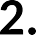


Slide 25
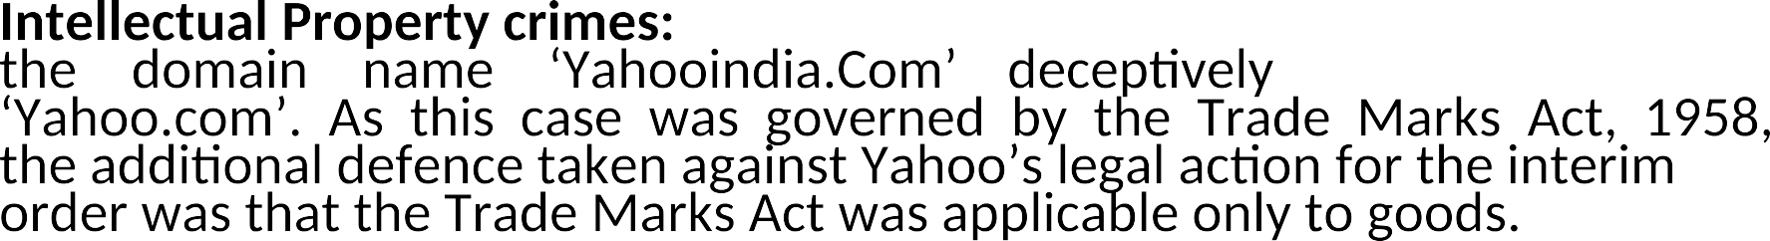
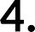
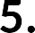

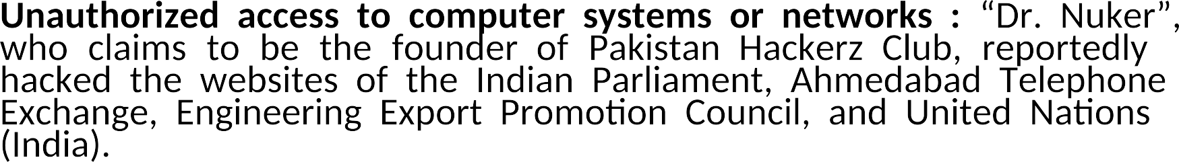

Slide 26

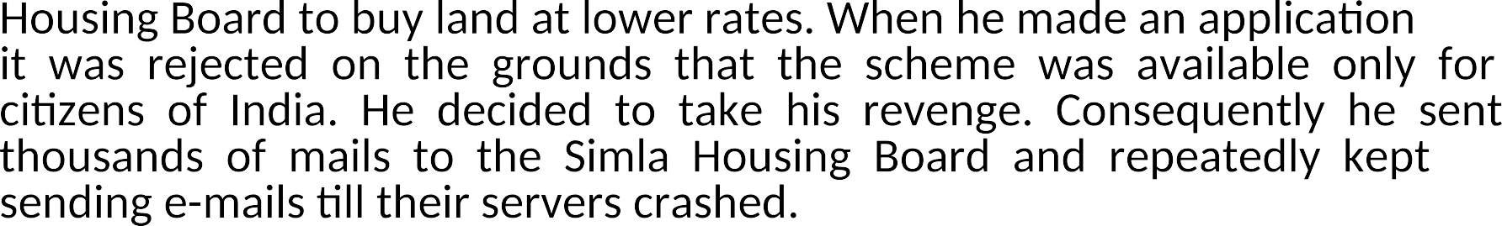



Slide 27
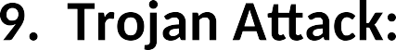

Slide 28



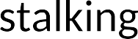

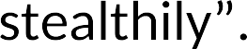

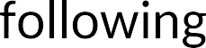
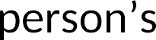



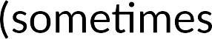

Slide 29




Pretend to be someone or something that you are not

Slide 30







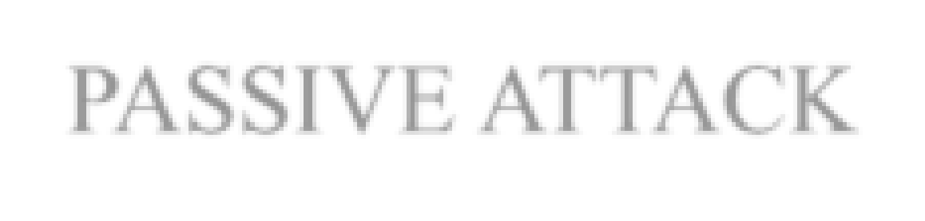
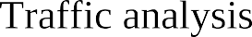



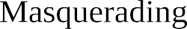
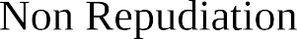



From a technical point of view, RFC 4270 (Attacks on Cryptographic Hashes in Internet Protocols) points out that Non-repudiation is “a security service that provides protection against false denial of involvement in a communication”.

Slide 31
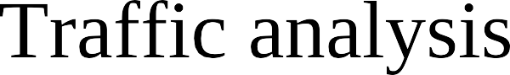

Slide 32




Slide 33














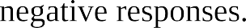

Slide 34


Slide 35


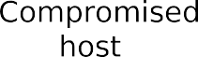

Slide 36


Slide 37




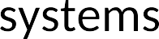



Slide 38


Slide 40


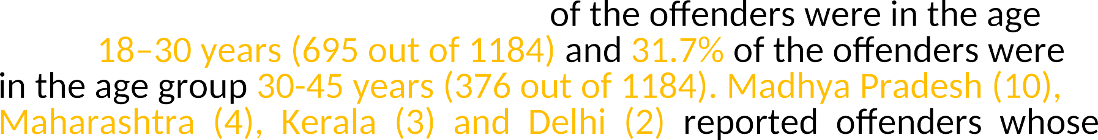




Slide 41
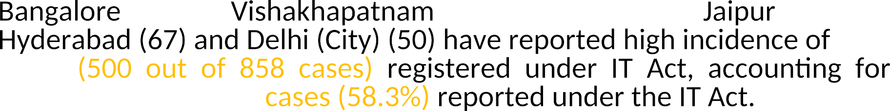


Slide 42
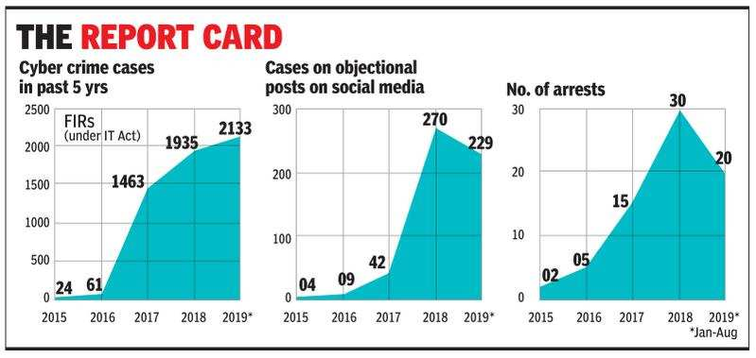

Slide 43
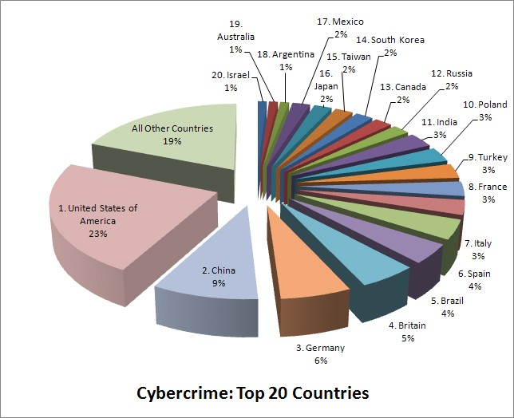

Slide 44
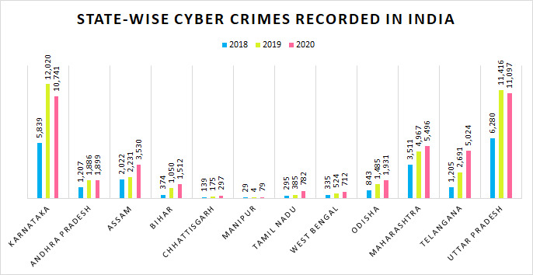

Slide 45
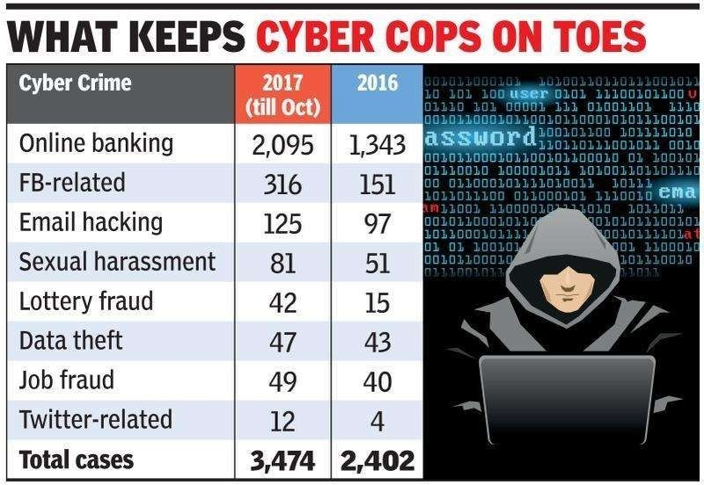

Slide 47


Slide 48


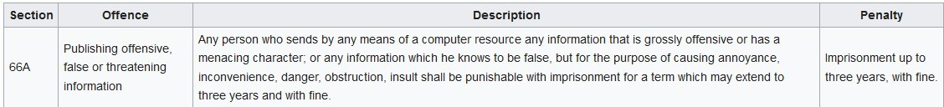

Slide 50
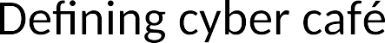
Amendment act 2008

Slide 51
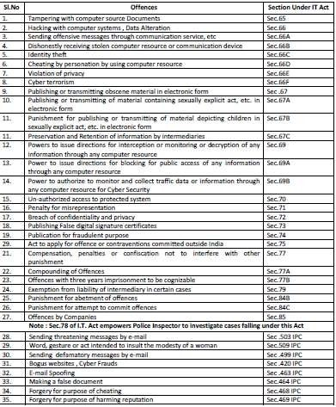

Slide 52
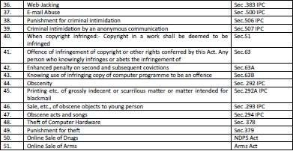

Slide 53
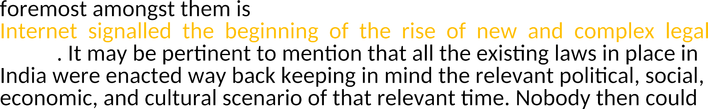


Slide 56







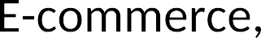

Slide 57


Slide 58

Physical damage

Slide 59
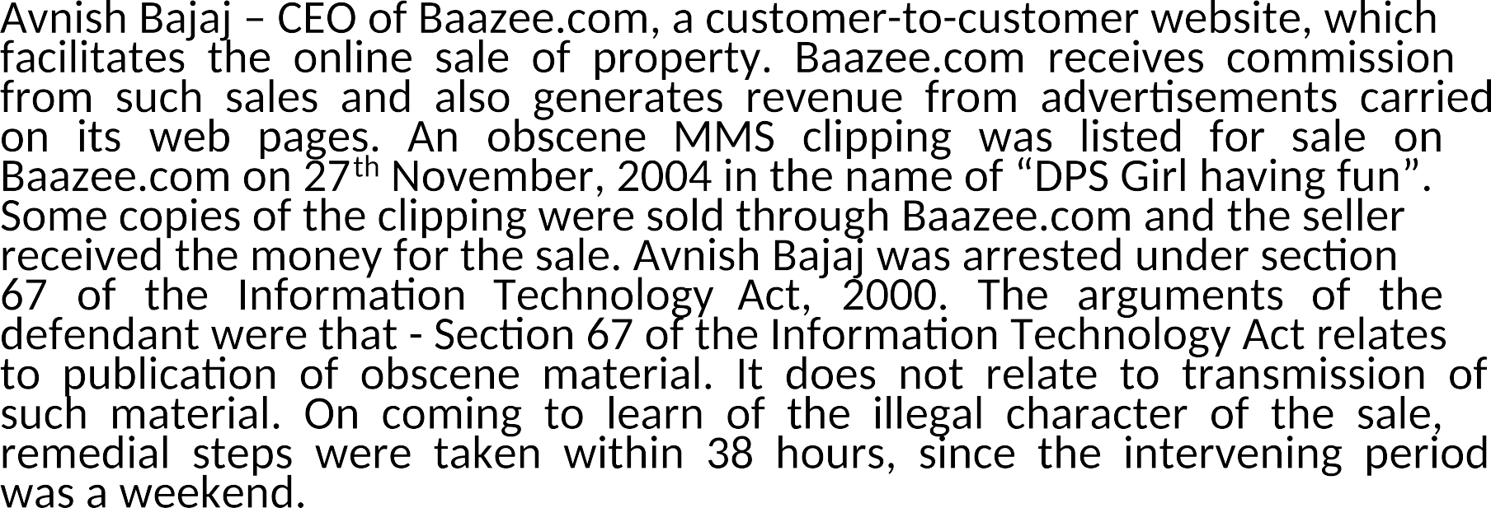

Slide 60







Slide 61











Without the knowledge of

Slide 62
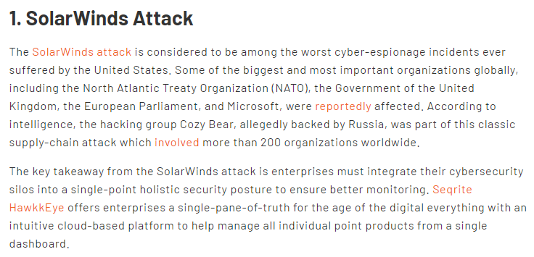

Slide 63
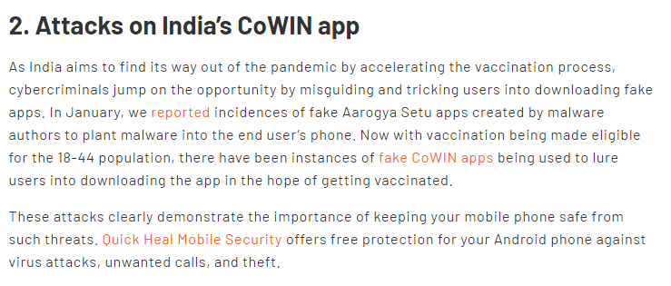

Slide 64


Slide 65


Slide 66


Slide 67


